Slide 1
Text Processing
0
1
2
3
4
H
E
L
L
O
SoftUni Team
Technical Trainers
Software University
https://softuni.bg

Slide 2
Table of Contents
Strings in JavaScript
Manipulating Strings
Searching, Substring
Trim
Split
More Functions

Slide 3
Questions?
sli.do
#fund-js

Slide 4
Strings
H
e
l
l
o
What is String?

Slide 5
What is String?
Strings are sequences of characters
Like arrays, they have a length property
Strings can be declared with three types of quotes
Concatenated using the "+" operator
let str = "Hello";
let str = 'Hello';
let str = `Hello`;
let s = "Hello" + " " + "JS";

Slide 6
Strings Are Immutable
Strings are immutable (read-only) sequences of characters
Accessible by index
Strings can also be iterated using for-of
let str = "Hello, JS";
let ch = str[2]; // Expected output: l
ch = str.charAt(2); // Expected output: l
// Both declarations are the same

Slide 7
Problem: Print Characters
Receive a string
Print all the characters on separate lines
A
W
o
r
d
function solve(string) { for (let ch of string) { console.log(ch); } }
'AWord'

Slide 8

Manipulating Strings

Slide 9
Concatenating
Use the "+" or the "+=" operators
Use the concat() method
let text = "Hello" + ", ";
// Expected output: "Hello, "
text += "JS!"; // "Hello, JS!"
let greet = "Hello, ";
let name = "John";
let result = greet.concat(name);
console.log(result); // Expected output: "Hello, John"

Slide 10
Searching for Substrings
indexOf(substr)
lastIndexOf(substr)
let str = "I am JavaScript developer";
console.log(str.indexOf("Java")); // Expected output: 5
console.log(str.indexOf("java")); // Expected output: -1
let str = "Intro to programming";
let last = str.lastIndexOf("o");
console.log(last); // Expected output: 11

Slide 11
Extracting Substrings
substring(startIndex, endIndex)
let str = "I am JavaScript developer";
let sub = str.substring(5, 10);
console.log(sub); // Expected output: JavaS

Slide 12
String Operations
replace(search, replacement)
let text = "Hello, john@softuni.bg, you have been using john@softuni.bg in your registration.";
let replacedText = text.replace(".bg", ".com");
console.log(replacedText); // Hello, john@softuni.com, you have been using john@softuni.bg in your registration.

Slide 13
Problem: Substring
Receives a string, a start index, and count characters
Print the substring of the received string
"ASentence", 1, 8
Sentence
"JavaScript", 4, 6
Script

Slide 14
Solution: Substring
function solve(text, startIndex, count) {
let substring = text
.substring(startIndex, startIndex + count);
console.log(substring);
}

Slide 15
Splitting and Finding
split(separator)
includes(substr)
let text = "I love fruits";
let words = text.split(' ');
console.log(words); // Expected output: ['I', 'love', 'fruits']
let text = "I love fruits.";
console.log(text.includes("fruits")); // Expected output: True
console.log(text.includes("banana")); // Expected output: False

Slide 16
Repeating Strings
repeat(count) - Creates a new string repeated count times
let n = 3;
for(let i = 1; i <= n; i++) {
console.log('*'.repeat(i));
}
// *
// **
// ***

Slide 17
Problem: Censored Words
Receives a text and a single word
Find all occurrences of that word in the text and replace them with the corresponding amount of '*'
A small sentence with some words,
small
A ***** sentence with some words

Slide 18
Solution: Censored Words
function solve(text, word) {
while (text.includes(word)) {
text = text.replace(word, '*'.repeat(word.length));
}
console.log(text);
}

Slide 19
Trimming Strings
Use trim() method to remove whitespaces (spaces, tabs, no-break space, etc. ) from both ends of a string
Use trimStart() or trimEnd() to remove whitespaces only at the beginning or at the end
let text = " Annoying spaces ";
console.log(text.trim()); // Expected output: "Annoying spaces"
let text = " Annoying spaces ";
text = text.trimStart(); text = text.trimEnd();
console.log(text); // Expected output: "Annoying spaces"

Slide 20
Starts With/Ends with
Use startsWith() to determine whether a string begins with the characters of a specified substring
Use endsWith() to determine whether a string ends with the characters of a specified substring
let text = "My name is John";
console.log(text.startsWith('My')); // Expected output: true
let text = "My name is John";
console.log(text.endsWith('John')); // Expected output: true

Slide 21
Padding at the Start and End
Use padStart() to add to the current string another substring at the start until a length is reached
Use padEnd() to add to the current string another substring at the end until a length is reached
Receives length and substring
let text = "010";
console.log(text.padStart(8, '0')); // Expected output: 00000010
let sentence = "He passed away";
console.log(sentence.padEnd(20, '.'));
// Expected output: He passed away......

Slide 22
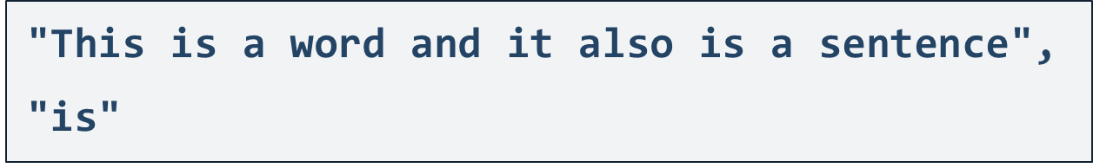
Problem: Count String Occurrences
Receive a text and a word that you need to search
Find the number of all occurrences of that word and print it
2

Slide 23
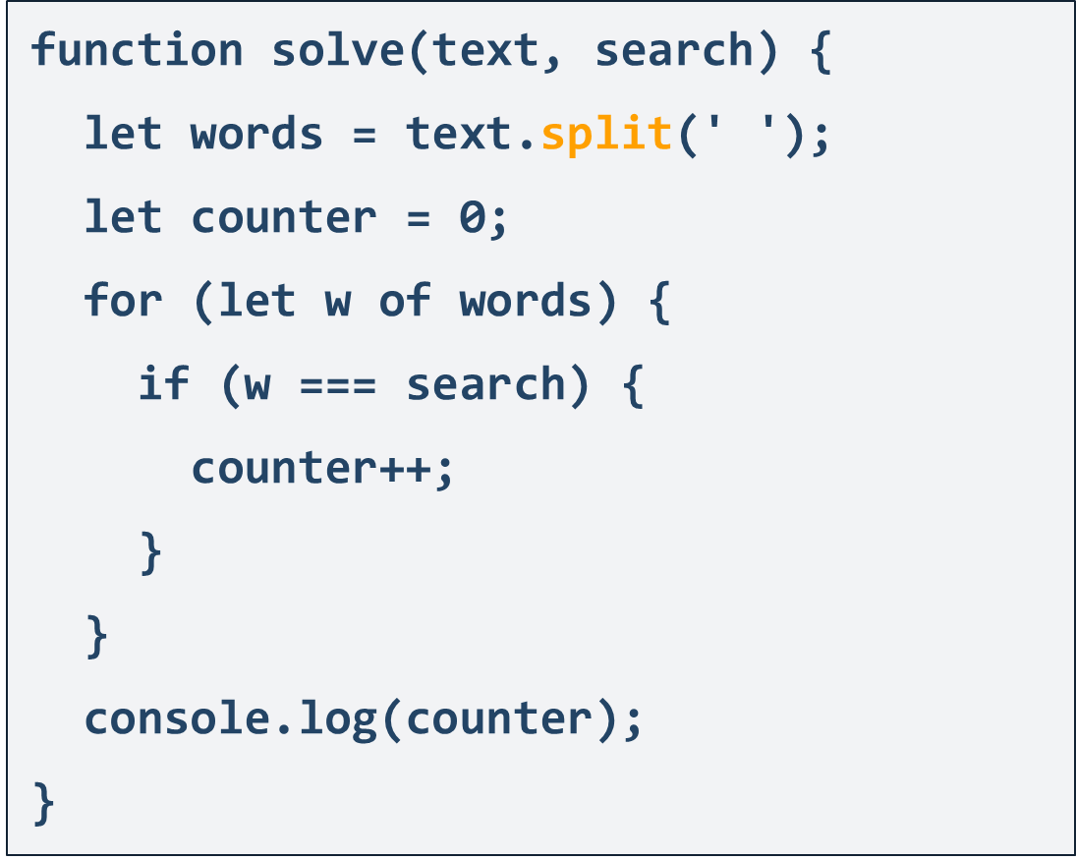
Solution: Count String Occurrences

Slide 24

Live Exercises

Slide 25
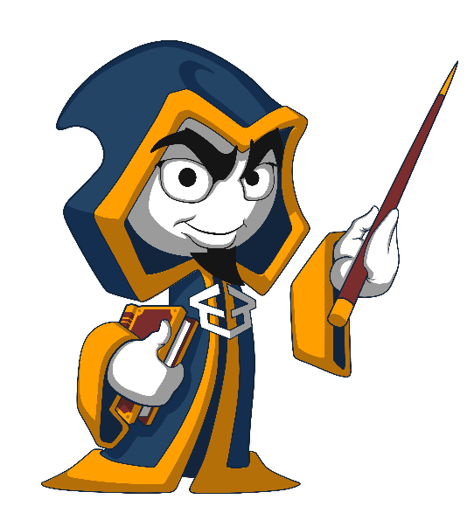
Summary
…
…
…
Strings are immutable sequences of Unicode characters
Strings can be indexed like arrays
String processing methods
concat(), indexOf(), includes(), substring(), split()

Slide 26
Questions?
Notes:
26

Slide 27














SoftUni Diamond Partners

Slide 28

Educational Partners

Slide 29
Trainings @ Software University (SoftUni)
Software University – High-Quality Education, Profession and Job for Software Developers
softuni.bg
Software University Foundation
softuni.foundation
Software University @ Facebook
facebook.com/SoftwareUniversity
Software University Forums
forum.softuni.bg
Notes:
29

Slide 30

License
This course (slides, examples, demos, exercises, homework, documents, videos and other assets) is copyrighted content
Unauthorized copy, reproduction or use is illegal
© SoftUni – https://about.softuni.bg/
© Software University – https://softuni.bg
Notes:
30

